Slide 1

StraySpotter
[source code website]
[project website]
Asa Dillahunty, Dylan Marcum-Pollard,
Lillian Presley, Sav Campbell

Slide 2
Project Overview
The focus of our project was to create an application that allowed the user to both upload pictures of stray animals that they find during their everyday lives and browse the pictures for sightings of their missing pets.
To do this, uploaded pictures needed to have their locations stored and we needed a way for those pictures to be found by the user. The idea was that if you knew where your animal was spotted, it could assist in finding your lost pet.
Notes:
Sav

Slide 3
Sprint Overview
Our goals for Sprint 2 included:
Allowing users to upload pictures - Lily
Custom geotagging - Asa
Start the user profiles page - Asa
5 test cases - Dylan
Read and write information to/from the database - Sav
Post flagging - moved to Sprint 3
Notes:
Dylan

Slide 4
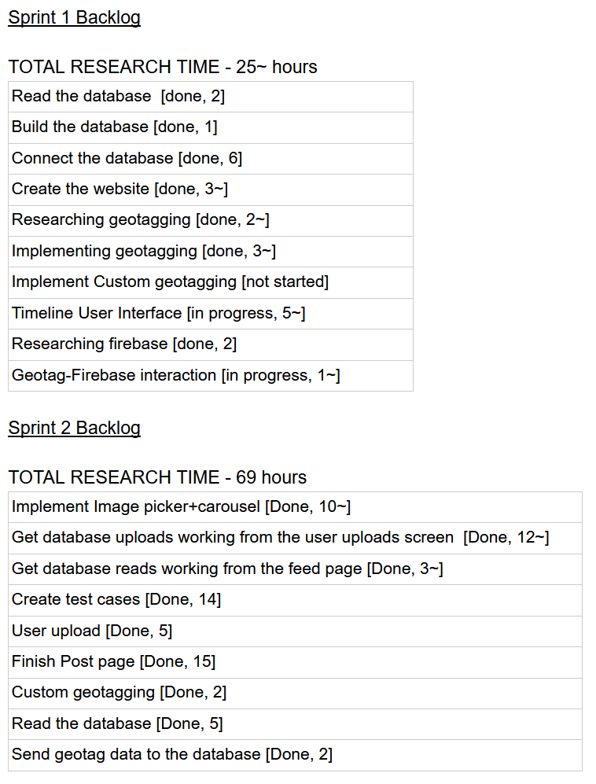
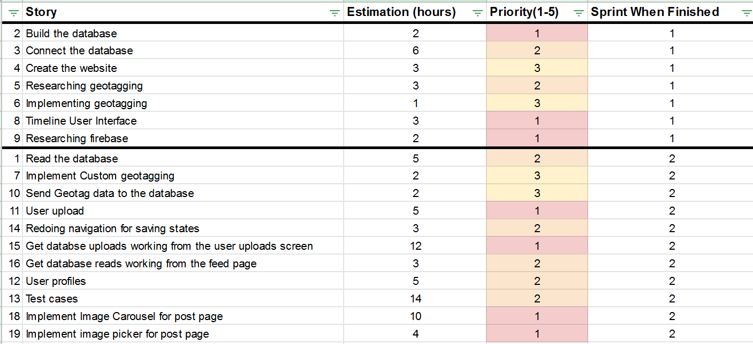
Sprint Backlog
Notes:
Asa

Slide 5
Sprint Reflection
We didn’t get to allowing users to flag and report posts.
The user profiles are not finished yet.
We prioritized updating navigation functionality over finishing the profiles.
The uploading of strays found and the timeline now work with the database in real time.
Photos permissions and image picker implemented.
Notes:
Lily- list this off

Slide 6
Demo Description
We will walk through the general UI of the app and then will show the frontend and backend of the app through a stray upload
Link to Firebase
Notes:
Link: https://console.firebase.google.com/u/2/project/stray-spotter/firestore/data/~2FStraysFound~2FGgRKktdJjojqZyFpMHmH

